Slide 1
WordPress on AWS: Be Global and Cloud-scale
Branislav Papulin
Developer
Novi Sad
Darko Mesaroš
Solutions Architect
Amazon Web Services
@darkosubotica

Slide 2
What is Cloud Computing?
Notes:
Timing: 30 secs – Total: 1

Slide 3


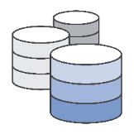

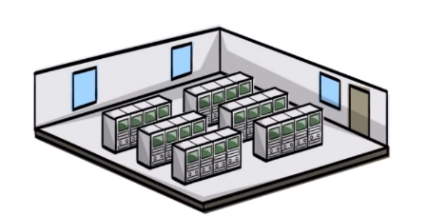


What is Amazon Web Services (AWS)?
Everything you’d want to do in a traditional datacenter
Run applications – reliably and securely
Provision network, compute, storage and database services in the cloud with the click of a button
Notes:
Timing: 120 secs – Total: 3:00
What are we trying to articulate on this slide:
This slide is intended to get more specific about AWS, how it relates to Amazon.com, and how unique we are in this industry.
Talking points:
Amazon is a unique company in how we operate.
Everything we do starts with our customers, and works back from there. 90 – 95% of our roadmap is driven by customer feedback
We are inventors and pioneers, and hire people that want to build the new normal.
We think long-term – We want to build relationships with customers that outlast us all.
How AWS got started:
Over a decade of experience building and operating Amazon.com.
Realized that we had developed a core competency in operating massive scale technologies and datacenters
Embarked on a mission to offer this to developers and businesses to build sophisticated, modern and scalable applications
AWS is the fastest-growing multi-billion enterprise IT vendor in the world
What this means is everything you’d want in the traditional datacenters, at your fingertips with the ability to click a button, to run applications reliably, securely and at scale
Relevant customer examples:
N/A
Conversations topics:
What does your technology and IT infrastructure look like today?
Where is it hosted?
Other tips:
Review the “How was AWS Started” and “What’s different about Amazon” details in the External Communication Training (https://kiku.aws.training/learningobject/wbc?id=24351)

Slide 4




What are the primary drivers for moving to the cloud?
Increased agility
Stop guessing capacity
$
Move from capital expense to variable expense
Breadth of services
Go global in minutes
Notes:
Timing: 120 secs – Total: 5:00
What are we trying to articulate on this slide:
This slide gives a more detailed overview of AWS and the specific value proposition that we bring to our customers.
Talking points:
There are 5 main advantages to AWS:
Agility
Cost Savings
Elasticity
Breadth of functionality
Global
Relevant customer examples:
From customers industry if possible
Commonwealth Bank of Australia – Halved their storage costs and estimate they will save hundreds of millions of dollars
…
Conversations topics:
Which one(s) of these are most important to the customer?
What problems are you trying to solve?
Other tips:
Review the “What are the advantages of moving to the AWS cloud?” in the External Communication Training (https://kiku.aws.training/learningobject/wbc?id=24351)
Understand the customer, and tailor this part of the conversation to their business. Perhaps lead with that question on this slide, and spend 80% of time discussing that, with 20% on the other bits

Slide 5
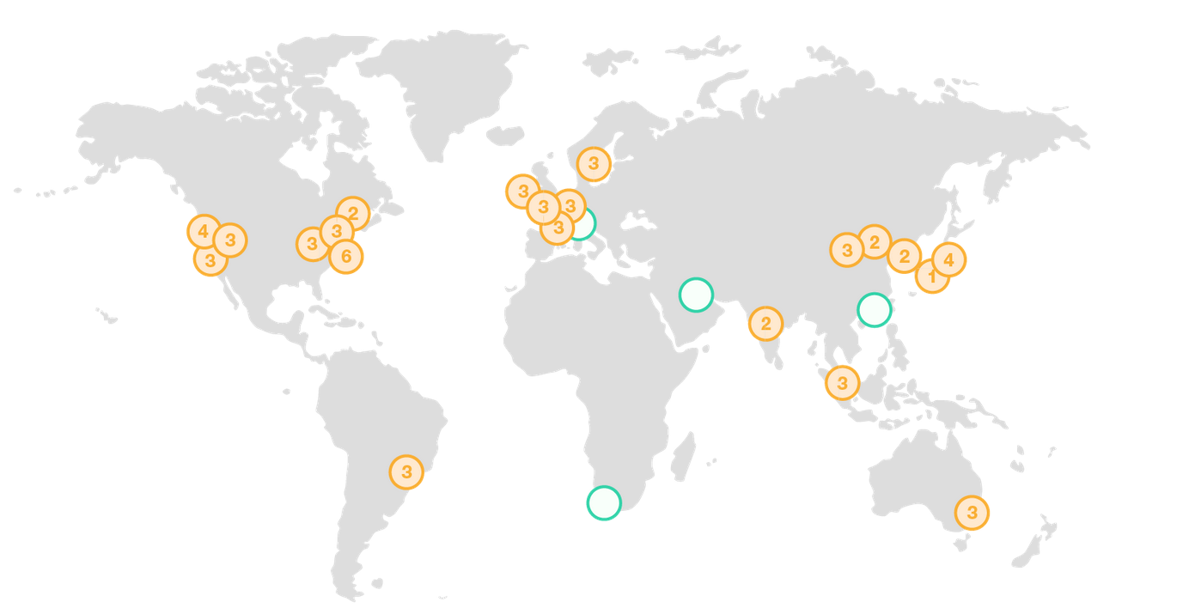
Global comes standard
The AWS Cloud spans 61 Availability Zones within 20 geographic regions around the world, with announced plans for 1 more Availability Zones and five more AWS Regions in Bahrain, Cape Town, Hong Kong SAR, and Milan.
Notes:
Timing: 60 secs – Total: 6:00
What are we trying to articulate on this slide:
This slide gives the customer an overview of our scale and reach, and ability to consistently serve them as they move into different markets.
Talking points:
To support global businesses we maintain 19 geographic regions around the world.
Each region is made up of clusters of datacenters known as Availability Zones. AWS Cloud Spans across 57 Availability Zones
Highlight the legend – Yellow circles = region and number of availability zone Green circles = regions coming soon
Region & Number of Availability Zones
US East N. Virginia (6), Ohio (3) US West N. California (3),Oregon (3) Asia Pacific Mumbai (2), Seoul (2), Singapore (3), Sydney (3), Tokyo (4), Osaka-Local (1)¹ Canada Central (2) China Beijing (2), Ningxia (3) Europe Frankfurt (3), Ireland (3), London (3), Paris (3) South America São Paulo (3) GovCloud (US) US-East (3), US-West (3)
Bahrain, Hong Kong SAR, Milan, Stockholm.
This reach is important because:
You can replicate your infrastructure in any region in the world in minutes
Data stays in the region you place it in—we do not move your data which is important in countries like Germany where locality is essential to doing business
You can architect your applications to span availability zones and regions to take advantage for both availability and low-latency performance for your users across the globe
Relevant customer examples:
This is an opportunity to pull in several customer names from across our customer base.
Conversations topics:
Where are your customers located?
What is your current infrastructure footprint?
Other tips:
Not all customers have a global need. Focusing these customers on the ability to build applications across AZs, discussing edge locations and other customer types here will be key.
Review the website to make sure this slide is updated with the correct public information.

Slide 6
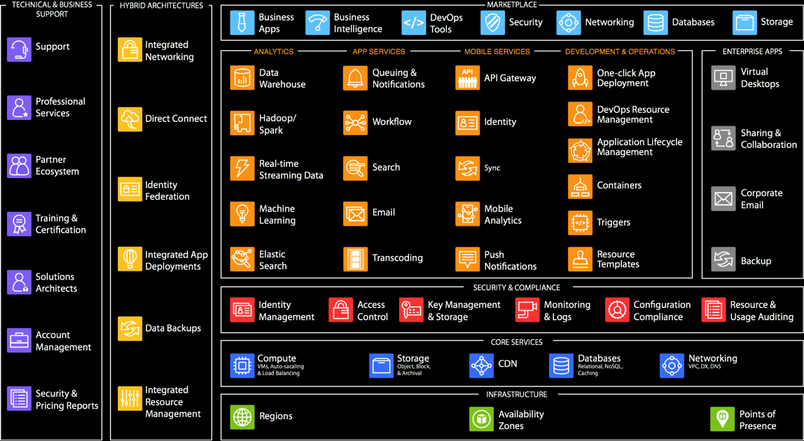
Broad and Deep Functionality
Notes:
Timing: 60 secs – Total: 7:00
What are we trying to articulate on this slide:
This slide demonstrates that we are not simply an infrastructure platform, but have solutions and technologies that solve virtually any technology need a customer may have.
Talking points:
Broadest range of services available.
There are a lot of different products and services and SAs are here to provide guidance that support each customer to meet the desired outcome.
Continually expanding our offerings to support any cloud workload, and now have more than 50 products
Customers can choose what is right for them, and use as much or as little AWS products as needed
Everything is built on core services such as Compute, Storage, Databases and Networking
Customers can leverage higher level services to remove undifferentiated heavy lifting, or continue to operate with core/primitive services to function as they have in the past
Higher level product categories range from Analytics such as data warehousing to Enterprise Applications such as corporate email and virtual desktops.
Discuss the depth of a handful of these services. For example, our database services offer several DB engines including MySQL, MSSQL, Oracle, PostgreSQL, etc. and include features such as multi-AZ replication, automatic backups, etc.
We offer a robust set of resources to help in the journey, such as professional services and support.
For commercial products, we have a larger partner ecosystem which offers technologies and tools from partners like F5, Cisco, etc.
Relevant customer examples:
Identify at least one other AWS customer that is relevant to this customer, and give details on a solution they’re running on AWS.
Conversations topics:
What kind of technologies and solutions are you leveraging today?
Where areas are working well for you, and which aren’t?
Do you have resources that spend time working on non-business related tasks (managing backups, storage admins, etc.)
Other tips:
This slide can be daunting at first glance, but is very powerful in telling our breadth and depth.
Take notice that there are no product name references here. We are abstracting our service/product names here, and driving toward the technology area that resonates with the customer
Go into the meeting knowing some technologies that the customer uses. This will require some prep work.
Practice telling your story with this slide, it is a great opportunity for the customer to explain what they are most interested in for Master Building meeting II.

Slide 7


An Expansive Ecosystem
Thousands of the world’s largest technology and consulting companies
48+ Global Premier Consulting partners
12+ Enterprise-focused competencies
2,200+ products available for 1-click deployment across 35 distinct product categories
Customers run over 143M hours of software per month
Notes:
Timing: 60 secs – Total: 8:00
What are we trying to articulate on this slide:
This slide helps customers know that they are not in this on their own, and that they won’t have to start from scratch.
Talking points:
Our ecosystem can be broken into 2 main categories, Systems Integrators and Independent Software Vendors.
AWS Partner Network (APN) includes the largest SIs such as Deloite and Accenture, as well regional and boutique partners like 2nd Watch that have built their practices around AWS.
APN also includes some of the largest ISVs such as Microsoft, Oracle and SAP that integrate into our platform, to those that have built their platform on top of AWS, such as Heroku, Engine Yard, etc.
The AWS Marketplace makes it easy to 1-click deploy software and solutions they need to build and run their businesses.
Marketplace simplifies licensing and billing for customers.
Gives access to thousands of commercial and open source solutions that customers are familiar with and already running in your existing environments.
Relevant customer examples:
N/A
Conversations topics:
Do you currently have AWS or cloud expertise in house?
Do you work with any consulting partners today?
What type of commercial and open source software do you leverage today?
Other tips:
Review the “Tell me more about your partner ecosystem” and “Tell me more about the AWS Marketplace” details in the External Communication Training

Slide 8







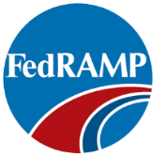





Critical certifications and compliance programs
Notes:
Timing: 60 secs – Total: 9:00
What are we trying to articulate on this slide:
Security is our number 1 priority, and the AWS Cloud has been architected to be the most flexible and secure cloud environments available.
Talking points:
AWS’ scale allows significantly more investment in security policing and countermeasures than almost any large company can afford themselves
Same security isolations that are employed in traditional datacenters
Physical data center security, separation of networks and isolation of hardware and storage
To validate this, we have achieved and secured for our customers several industry recognized certifications such as SOC1, SOC2, SOC3 and ISO27001
Can run HIPAA and PCI compliant workloads on AWS
All customers inherit best practices of policies, architecture and processes that have been built to satisfy the needs of most security sensitive customers.
Shared Security responsibility – We take care of security of the cloud, you take care of security in the cloud. This means that you have the flexibility to put more emphasis on security of sensitive data, and adjust as needed in areas where you have less concern.
Relevant customer examples:
Capital One CIO, Rob Alexander: "The financial service industry attracts some of the worst cyber criminals. We work closely with AWS to develop a security model, which we believe enables us to operate more securely in the public cloud than we can in our own data centers." https://aws.amazon.com/solutions/case-studies/capital-one/
Conversations topics:
What kind of security controls or certifications are you bound by?
Other tips:
Review the “Is the AWS Cloud secure” and “What are the key competitive differentiators between AWS and other cloud providers” details in the External Communication Training

Slide 9
AWS Globalna Infrastruktura

Slide 10
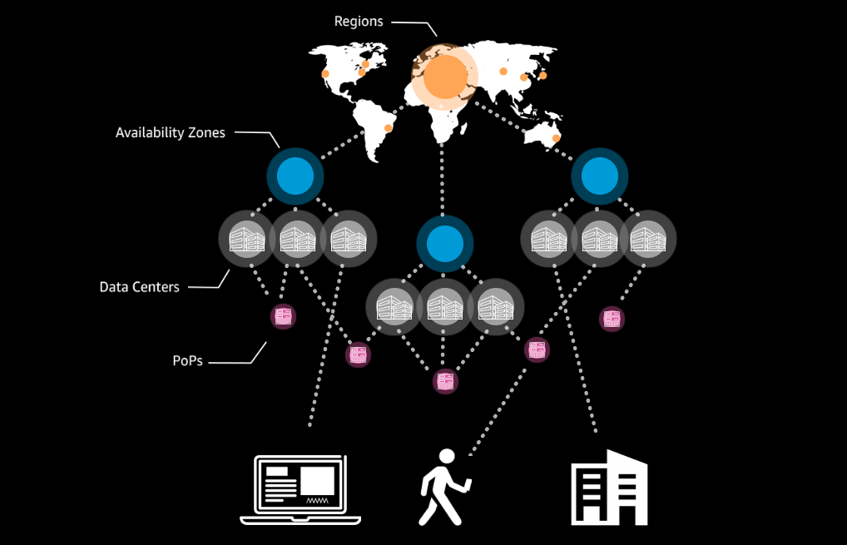
Komponente AWS Globalne Infrastrukture
Regioni
Availability zone
Data Centeri
Points of Presence
WordCamp Niš 2019
© 2019, Amazon Web Services, Inc. or its affiliates. All rights reserved.

Slide 11
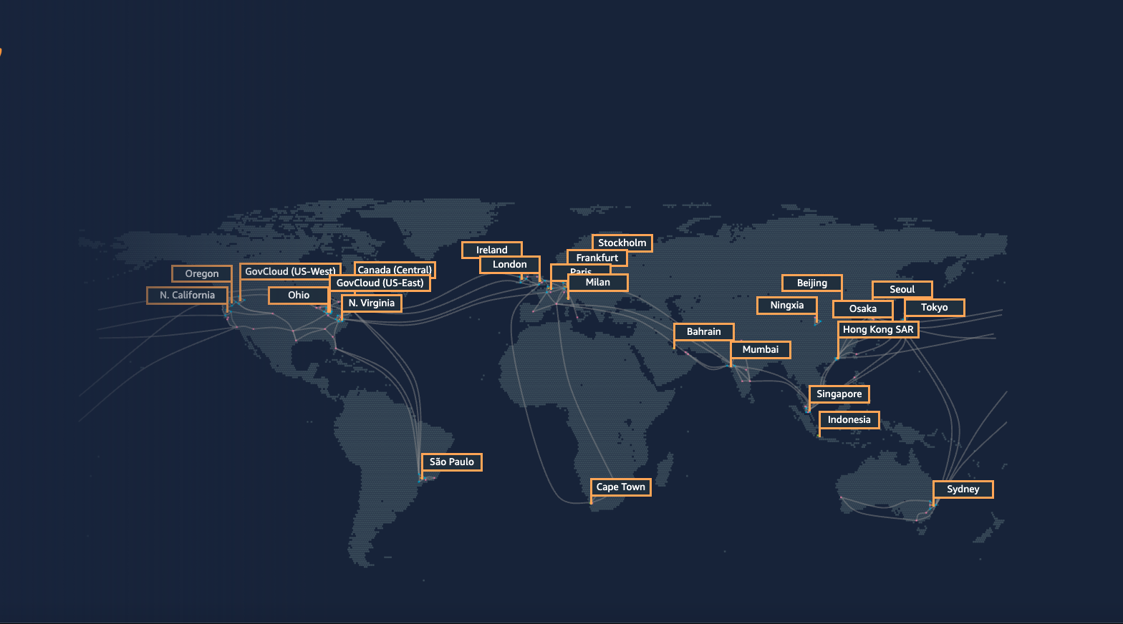
AWS Regioni
AWS Cloud se prostire na 64 Availability Zone unutar 21 geografskog regiona na svetu.
U plan je otvaranje još 12 Availability Zona i 4 nova regiona: Bahrain, Cape Town, Jakarta i Milano.
WordCamp Niš 2019
© 2019, Amazon Web Services, Inc. or its affiliates. All rights reserved.

Slide 12

AWS Availability Zone
WordCamp Niš 2019
© 2019, Amazon Web Services, Inc. or its affiliates. All rights reserved.

Slide 13




Prednosti koje nudi AWS globalna infrastruktura
Upotrebom najkvalitetnije globalne mreže koja je trenutno dostupna
AWS globalna infrastruktura je dizajnirana i izgrađena da omogući najveću:
Brzinu
Dostupnost i
pouzdanost
Fleksibilnost i
skalabilnost
Sigurnost
WordCamp Niš 2019
© 2019, Amazon Web Services, Inc. or its affiliates. All rights reserved.

Slide 14
Amazon S3

Slide 15
Amazon Simple Storage Service - S3
Amazon S3 je object storage napravljen sa ciljem da prihvati i distribuira bilo koju količinu podataka sa bilo koje lokacije na Internetu.
Ovaj servis nudi ekstremnu trajnost, visoku dostupnost i neograničenu skalabilnost smeštanja podataka.

Slide 16
Amazon S3 Storage klase
Amazon S3 Standard (S3 Standard)
Amazon S3 Intelligent-Tiering
Amazon S3 Standard-Infrequent Acces
Amazon S3 One Zone-Infrequent Access
Archive
Amazon S3 Glacier
Amazon S3 Glacier Deep Archive

Slide 17
Performanse S3 Storage klasa
Trajnost (Durability): 99.999999999% - 11 x 9
Dostupnost (Availability)
  S3 Standard: 99.99%
  S3 Intelligent-Tiering: 99.9%
  S3 Standard-IA: 99.9%
  S3 One Zone-IA: 99.5%
  S3 Glacier: 99.99%
  Deep Archive: 99.99%

Slide 18
Amazon S3 kontrola pristupa i sigurnost
?
Identity and
Access Management
(IAM)
Access Control Lists (ACLs)
Bucket Policies
Query String Authentication
WordCamp Niš 2019
© 2019, Amazon Web Services, Inc. or its affiliates. All rights reserved.

Slide 19
Amazon CloudFront

Slide 20
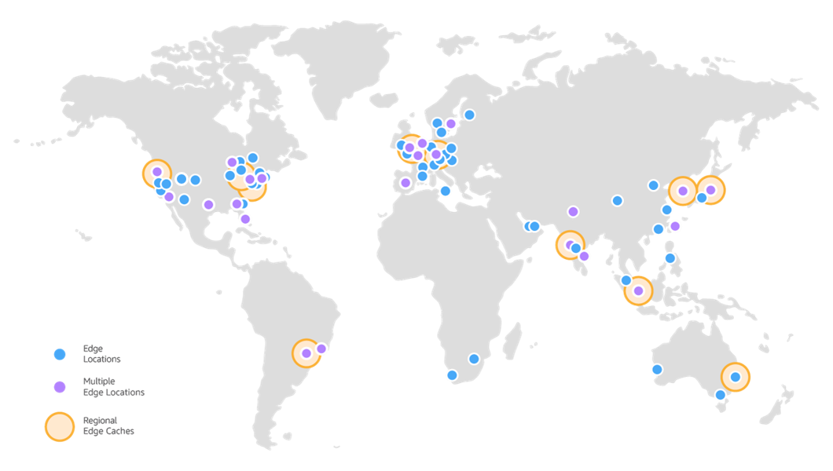
Amazon CloudFront Infrastruktura
Amazon CloudFront Global Edge Network
  180 Points of Presence
  169 Edge Lokacija
  11 Regional Edge Caches
  u 69 gradova
  30 zemalja
WordCamp Niš 2019
© 2019, Amazon Web Services, Inc. or its affiliates. All rights reserved.

Slide 21
Amazon CloudFront
Amazon CloudFront je content delivery network (CDN) servis koji na siguran način dostavlja podatke, video fajlove i aplikacije korisnicima širom sveta sa malom latentnošću (low latency) i velikom brzinom prenosa.
CloudFront je integrisan sa AWS – i na fizičkim lokacijama direktno povezanim na AWS globalnu infrastrukturu kao i sa ostalim AWS servisima.
CloudFront besprekorno funkcioniše sa servisima kao što su AWS Shield for DDoS mitigation.
Kao i sa Amazon S3, Elastic Load Balancing ili Amazon EC2 kao izvor (origins) za vaše aplikacije.
AWS Free Tier nudi 50GB data transfer out, 2,000,000 HTTP and HTTPS Requests sa Amazon CloudFront.

Slide 22
Amazon CloudFront
Keširanje statičnog sadržaja
  Amazon CloudFront može da ubrza isporuku Vašeg statičnog sadržaja (slike, style sheets(CSS), JavaScript) korisnicima širom sveta.
Sigurnost
  CloudFront besprekorno funkcioniše sa servisima kao što su AWS Shield for DDoS mitigation kao i sa AWS WAF za Layer 7 protekciju. CloudFront podržava TLS konekcije kao i autentifikovanje posetilaca sa potpisanim linkovima (signed URLs). CloudFront je takođe povezan i sa Amazon Certificate Manager (ACM) za automatizovano obnavljanje SSL sertifikata.
Geo Restrictions
  Ukoliko imate potrebu da onemogućite pristup svojim podacima korisnicima koji se nalaze u određenim zemljama, na raspolaganju Vam je whitelist (zemlje kojima je pristup dozvoljen) ili blacklist (zemlje kojima pristup nije dozvoljen).

Slide 23
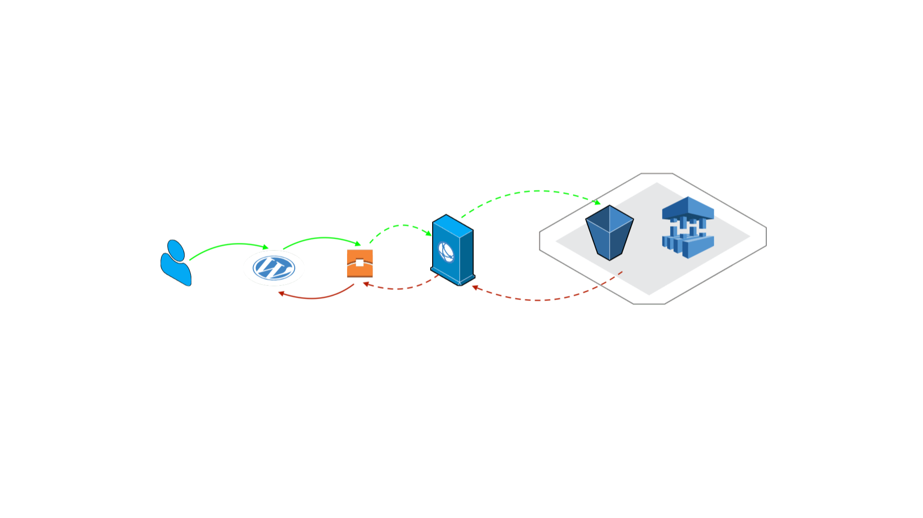
Kako CloudFront funkcioniše - Regional Edge Cache
Regional edge caches su CloudFront lokacije koje su postavljene globalno. Oni se nalaze između origin server ( ili s3) i Global Edge Lokacije koja isporučuje sadržaj direktno korisniku.
Kada objekat postane manje popularan, lokalne edge lokacije mogu taj objekat da obrišu kako bi napravile mesta za neke druge popularnije objekte.
Regionalni Edge Location ima veći keš pa objekat ostaje duže u njemu. Na ovaj način sadržaj ostaje bliže korisniku i smanjuje se potreba da CloudFront sadržaj preuzima sa web servera.
  180 Points of Presence
  169 Edge Lokacija
  11 Regional Edge Caches

Slide 24
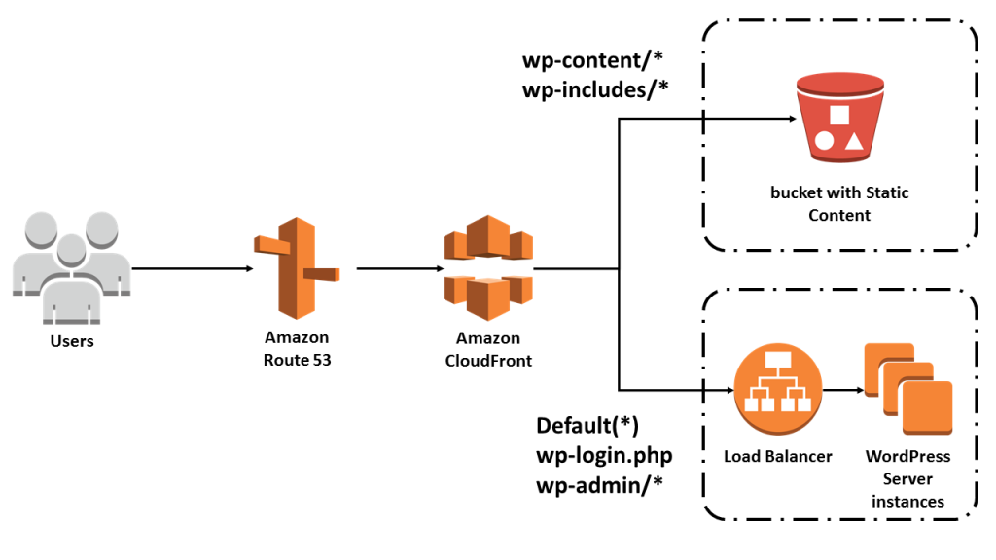
Dynamic Whole Site Delivery with Amazon CloudFront
Statički sadržaj je smešten na S3
Wordpress se opsluđuje sa EC2 instance, Lightsail ili nekog drugog hosting servera.
Postoji nekoliko plugin-a koji pojednostavljuju prenos statičkog sadržaja na S3. Jedan primer je W3 Total Cache.
Vaš website će postati brži bilo da koristite S3 za smeštanje statičkog sadržaja ili ne.
Uobičajenu Wordpress arhitektura

Slide 25
Statični Website

Slide 26
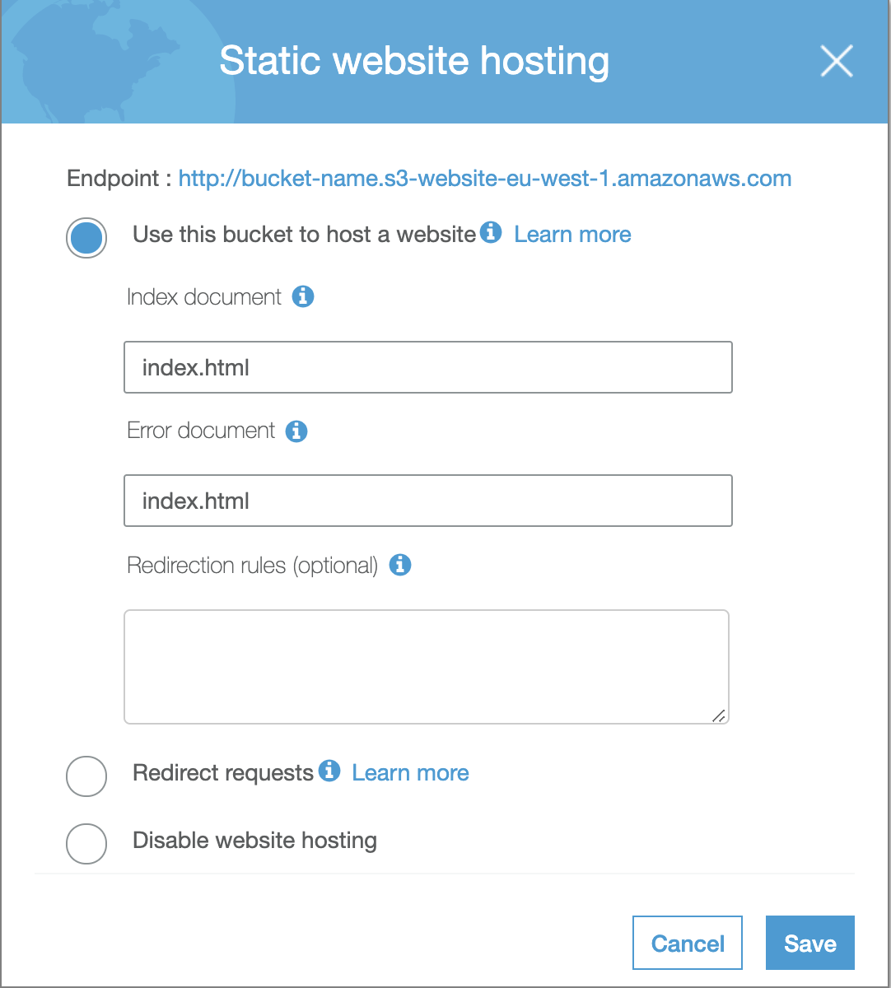
Hostovanje statičnog website-a na Amazon S3
Možete hostovati statični website na Amazon Simple Storage Service (Amazon S3).
Sve stranice statičnog website-a sadrže statični sadržaj. Takođe, mogu sadržati client-side skript.
Nasuprot njima, dinamični satovi se oslanjaju na serversko procesuiranje koje ukjučuje i skriptove kao što su PHP, JSP, ili ASP.NET. Amazon S3 ne podržava server-side skriptove.
U kombinaciji sa Amazon CloudFront servisom, omogućeno je korišćenje HTTPS protokola.

Slide 27


Serverless-Static WordPress Hosting
Deploy secure sites that scale and end downtime with Shifter, the serverless hosting solution and static site generator for WordPress.
WP plugin serverless forma
https://wordpress.org/plugins/wp-serverless-forms/
WordCamp Niš 2019
© 2019, Amazon Web Services, Inc. or its affiliates. All rights reserved.

Slide 28
How does this look on AWS?

Slide 29
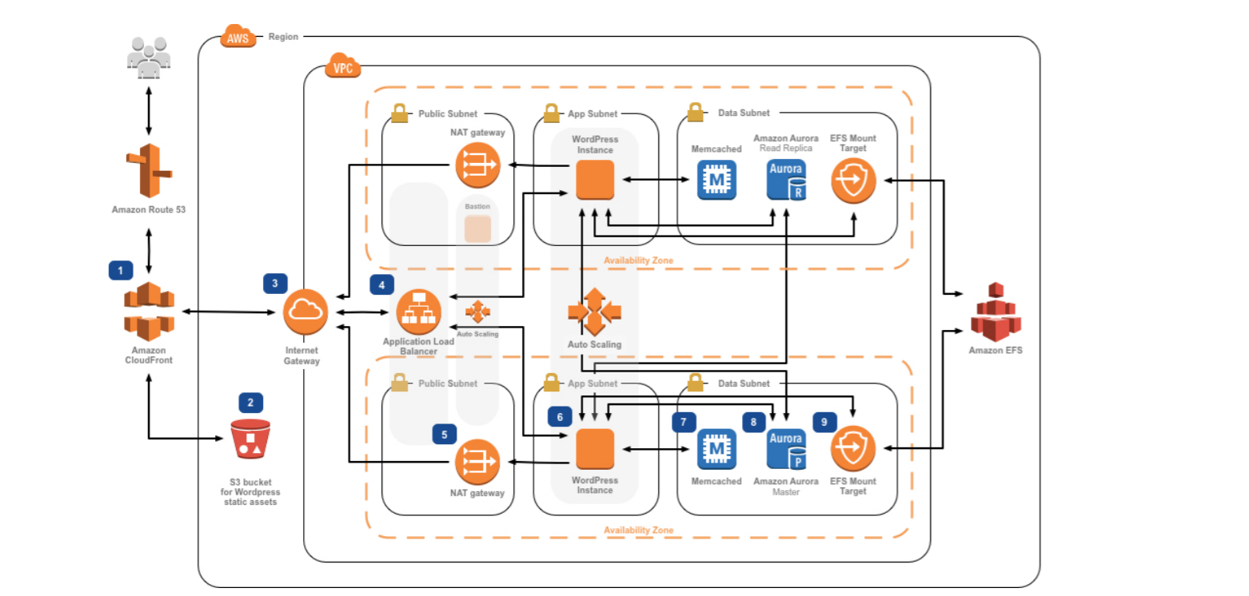
AWS WordPress Reference Architecture
Notes:
Stateless servers
Pets vs cattle
Cloud-Scale

Slide 30
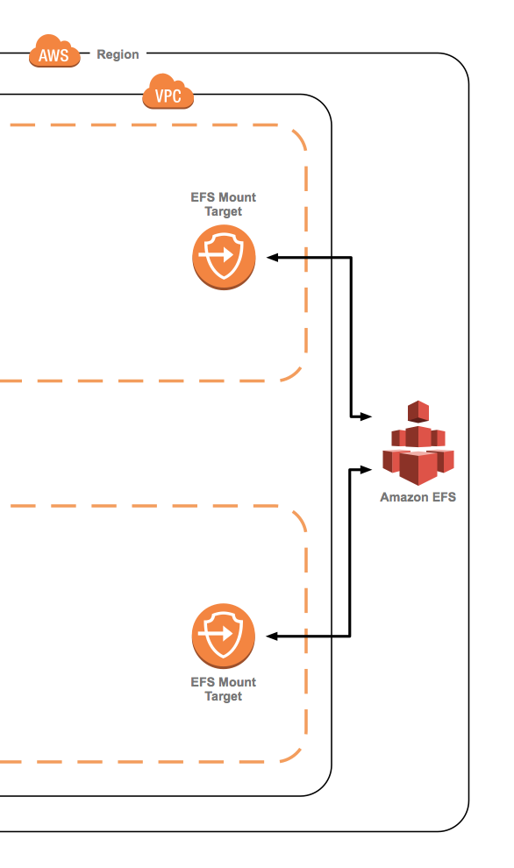
Store WordPress on a shared file system
All web servers will access the same file system
Achieve high availability and durability
Scale out with multiple threads and connections
Notes:
- Move the data off the EC2 instances – it becomes stateless

Slide 31
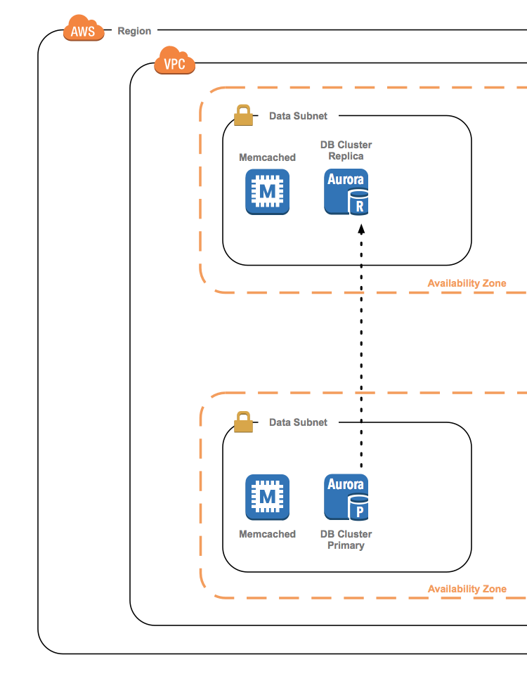
Use relational database as a service
Allow AWS to manage database tier
Achieve high availability and high durability
Scale out with Amazon Aurora replicas
Automatically grows storage as needed
Notes:
We talked about moving that data -- lets move the database
6 replicas of data
4 nines of availablility
Continuous backup ot S3
Failover is automatically handled.
Have a replica
Elasticache offloads some of the read activity.

Slide 32
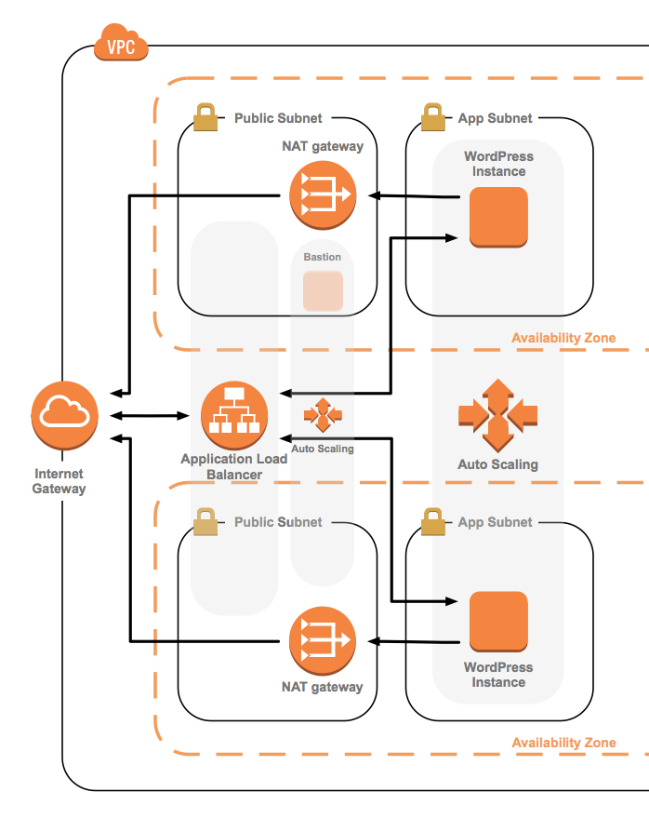
Load balance with Auto Scaling web servers
Allow AWS to manage load balancing across multiple AZs
Achieve better fault tolerance
Trigger Auto Scaling to scale out and in on demand
Run web servers in private subnets and NAT Gateway for public outbound access
Notes:
Session data is being stored on the client in the form of a cookie – that means no state data on the Web tier.
We stongly recommend using OPCache (It is part of this Reference Architecture – OPCache and OPCache monitor)
Notice the Bastion hosts – hey security!

Slide 33
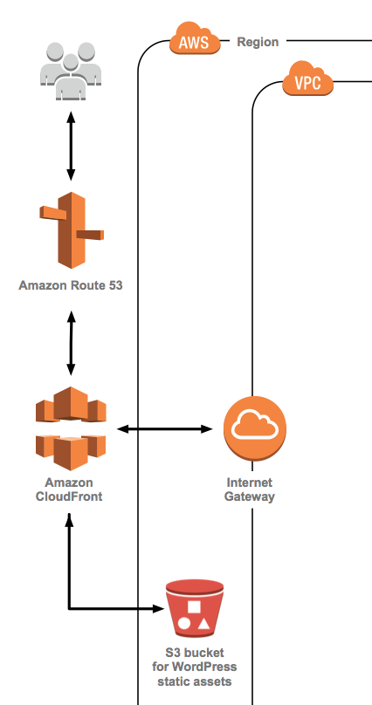
Cache content close to end users
For a good user experience
Use CloudFront to cache content
CloudFront has 180 edge locations worldwide, as of May 2019
Notes:
Take advantage of the edge network
Try to cache as much as we can – up at the edge closer to the end user.

Slide 34
AWS WordPress Reference Architecture

Slide 35
How do we deploy all that?
Notes:
- How many people do you have in your team?

Slide 36








AWS CloudFormation 101
Code in YAML or JSON directly or use sample templates
Upload local files or from an S3 bucket
Create stack using console, API or CLI
Stacks and resources are provisioned

Slide 37
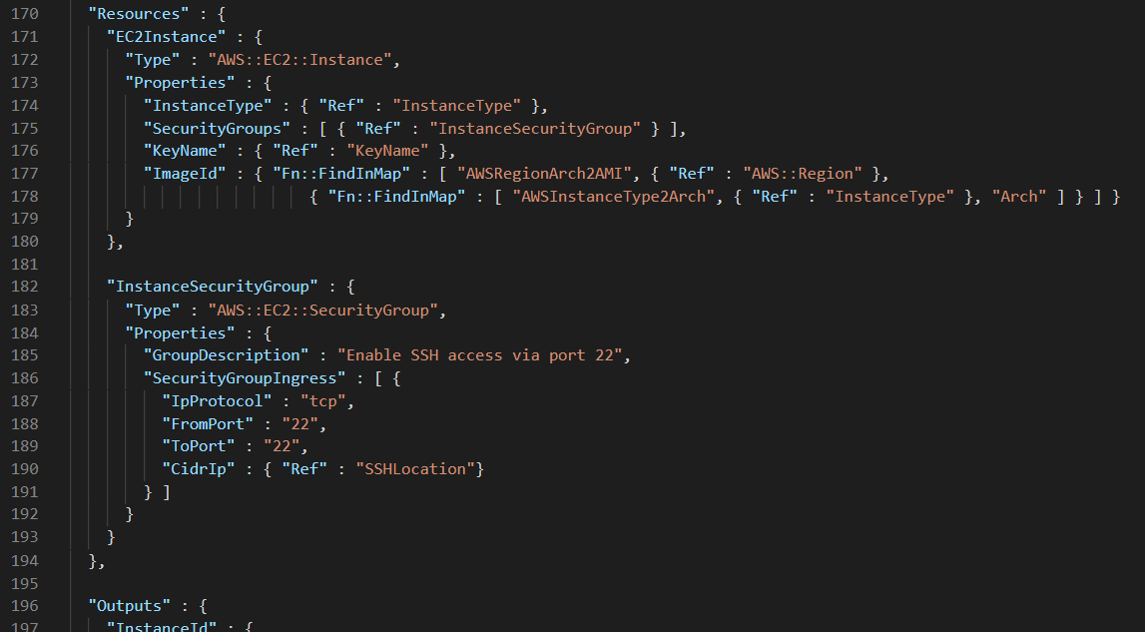
AWS CloudFormation 101

Slide 38
Monitoring?

Slide 39







Amazon CloudWatch
Spot trends
Centralize monitoring
Monitor EC2
CloudWatch is a monitoring service for AWS cloud resources and applications you run on AWS or on-premises
Monitor & store logs
Troubleshoot
Set alarms - events
Create dashboards

Slide 40
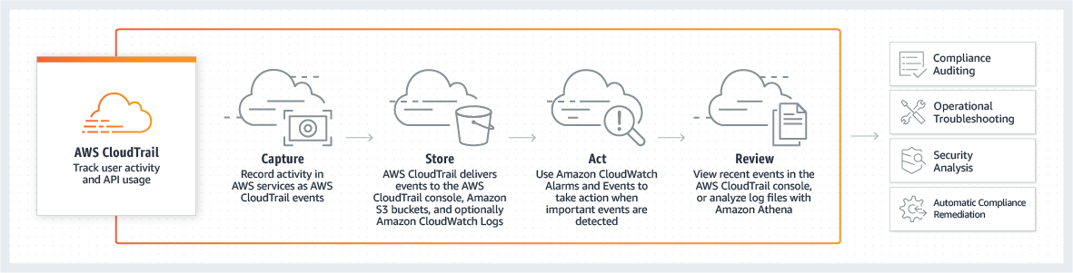
AWS CloudTrail
Keep track of API usage in a single location, simplifying audit and compliance processes
Perform security analysis and detect user behavior patterns across services, users, and accounts
Stay alert to data exfiltration risks by collecting activity data on Amazon Simple Storage Service (Amazon S3) objects through object-level API events
Simplify root cause analysis and reduce to time to resolution using AWS CloudTrail events
Notes:
CloudTrail enables you to track activity uniformly across services, teams, accounts, and organizations using a single point of control and a single source of truth.
CloudTrail gives you the ability to explore activity information using a single set of tools, and the ability to detect and respond to important changes in minutes.
It’s built in to AWS, is maintained by AWS, and covers the vast majority of services automatically.
CloudTrail support for new services is managed by AWS, so you don’t have to worry about supporting new services and features.
And most importantly, CloudTrail provides a consistent and broad view of AWS API activity in your application stacks.
It’s also easy to set up and maintain, simplifying your oversight process.
Those of you who are familiar with CloudTrail’s historic feature set may have noticed that I mentioned organizations, I’ll share the good news on that topic shortly.
CloudTrail gives you an enhanced toolset when managing governance and operations.
You can simplify your compliance activities, by leveraging CloudTrail’s event logs as a centralized source of truth for monitoring activity across accounts. This also makes security analysis easier, providing a broad and deep view of activity which is easy to drill into.
You can track activity which may suggest the presence of data exfiltration risks. This reduces your time to resolution, decreasing the window of opportunity for data breaches. You can also monitor the use of critical lambda functions which access sensitive systems, quickly taking action if critical systems are compromised.
And finally operational troubleshooting can be augmented using CloudTrail. Sometimes the hardest problem is finding out where to start looking for the root cause of a problem, and CloudTrail can help you funnel the possibilities fast.

Slide 41





AWS Config & AWS Config rules
Continuously track resource configuration changes
Evaluate the configuration against policies defined using AWS Config rules
Receive alerts if the configuration is noncompliant with your policies using Amazon SNS and Amazon CloudWatch Events
Notifications
Normalized
API Access
Changing resources
AWS Config
AWS Config Rules
History, snapshot
Notes:
From an inventory and configuration management perspective, when you enable AWS Config, it will automatically discover resources that exist in your account and record their current configuration as well as relationships with other resources. It will then start tracking any configuration changes that occur to those resources and alert you via SNS or CloudWatch notifications, in near real-time. In other words, AWS Config is a continuous configuration auditor.
From a configuration compliance management perspective, AWS Config provides a mechanism to evaluate the configuration of your resources against policies or best practices. For e.g. you may want to ensure that certain S3 buckets aren’t publicly readable or writeable. And you may want to do this not just for one account but for all AWS accounts under your management. Config Rules provide you with several rules out-of-the-box that you can instantly apply across all your accounts and regions to establish a good baseline. You can also author your own rules using custom rules or benefit from our community sourced rules in Github. Here you will find rules for checking CIS best practices, HIPAA or PCI, so these rules benefit many industry verticals. Config rules support centralized reporting, so you can aggregate the compliance results from multiple accounts and regions into a central account. And lastly, you can view when your resource went in and out of compliance by looking at the compliance history.

Slide 42
What about operations?

Slide 43
AWS Systems Manager
State Manager
Resource Groups
Patch Manager
Maintenance Window
Run Command
Automation
Session Manager
Inventory
Parameter Store
Distributor

Slide 44
Secure it!

Slide 45
Secure it!
AWS IAM
GuardDuty
CloudFront
WAF and Shield
Notes:
IAM control access to your AWS Resources
Guard Duty – Intelligent scanning of aws resources/logs
Cloudfront – CDK
WAF – Firewall – manage what you block and what you allow
Shield – DDoS protection

Slide 46

AWS WordPress Reference Architecture
Notes:
Stateless servers
Pets vs cattle
Cloud-Scale

Slide 47
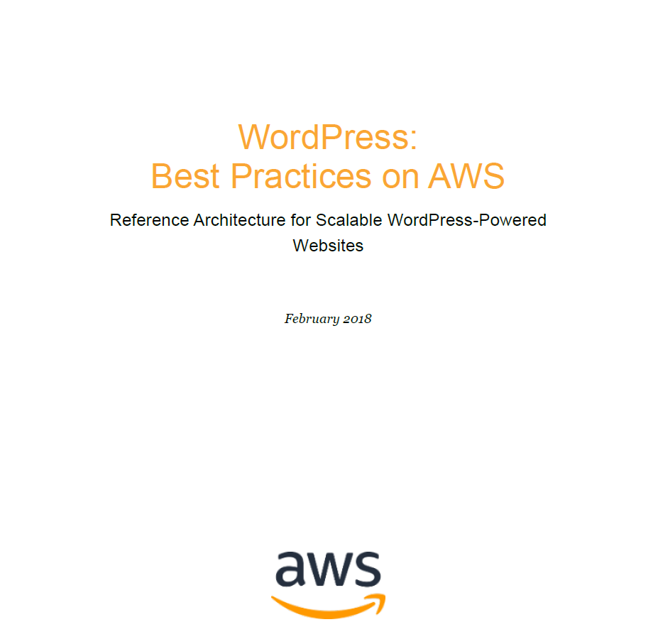
AWS WordPress Whitepaper
Notes:
Stateless servers
Pets vs cattle
Cloud-Scale

Slide 48

AWS WordPress Whitepaper
Notes:
Stateless servers
Pets vs cattle
Cloud-Scale

Slide 49
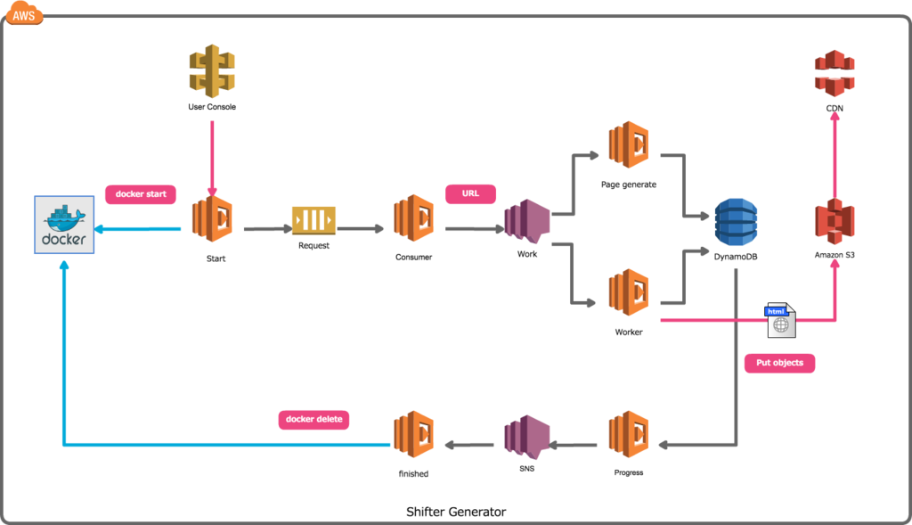
Amazon Infrastuktura - Shifter Backend
Resource: serverless.com
WordCamp Niš 2019
© 2019, Amazon Web Services, Inc. or its affiliates. All rights reserved.

Slide 50
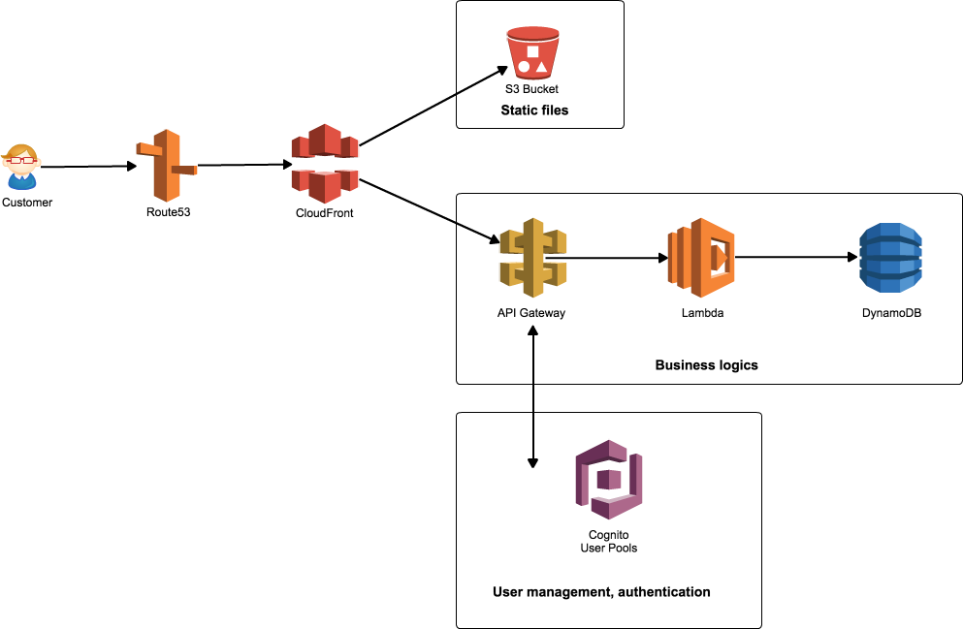
Amazon Infrastuktura - Shifter User Console
Resource: serverless.com
WordCamp Niš 2019
© 2019, Amazon Web Services, Inc. or its affiliates. All rights reserved.

Slide 51
Wrap Up
Offload your databases to RDS
Use EFS to make your Web tier stateless
Create all of that with Cloudformaton
Store your static content in S3 and cache with Cloudfront

Slide 52
Resources
https://d1.awsstatic.com/whitepapers/wordpress-best-practices-on-aws.pdf
https://aws.amazon.com/blogs/startups/how-to-accelerate-your-wordpress-site-with-amazon-cloudfront/
https://wordpress.org/plugins/w3-total-cache/
https://www.getshifter.io/
https://wordpress.org/plugins/wp-serverless-forms/
https://support.getshifter.io/contact-forms/using-wp-serverless-forms-wordpress-plugin-with-basin
https://northstack.com/

Slide 53
Darko Mesaroš
@darkosubotica
Branislav Papulin

